Slide 1

ACL(Access Control List)
访问控制列表

Slide 2
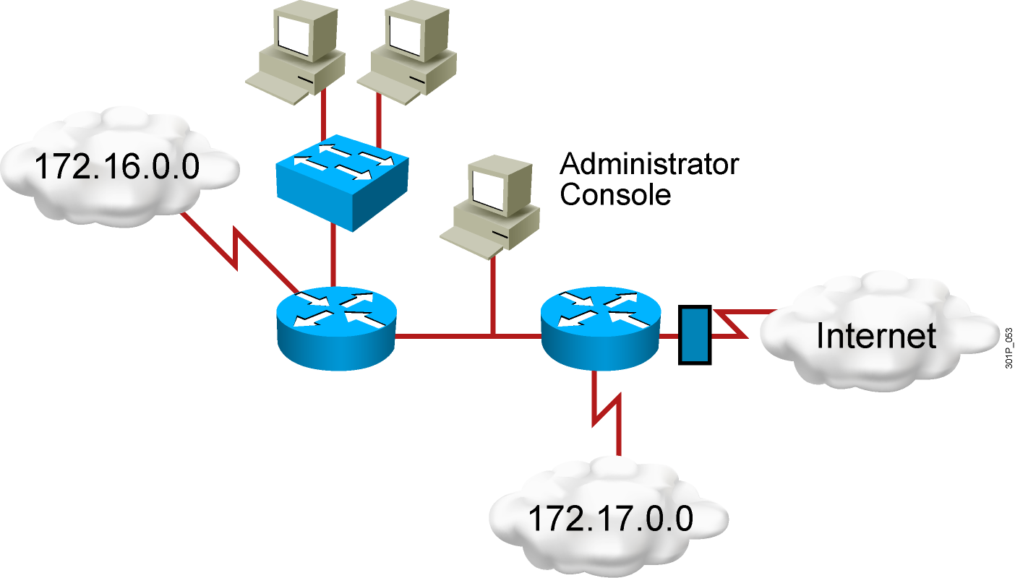
为什么要用ACL？
Filtering: Manage IP traffic by filtering packets passing through a router
Classification: Identify traffic for special handling
Notes:
Layer 2 of 2
Emphasize: An access list is a mechanism for identifying particular traffic. One application of an access list is for filtering traffic into or out of a router interface.

Slide 3
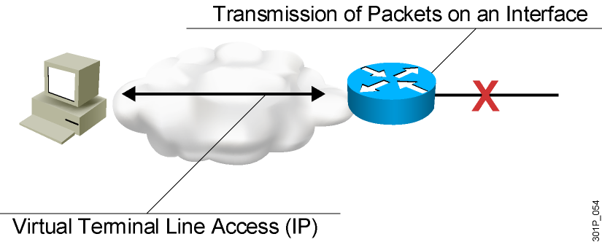
ACL的应用: Filtering
Permit or deny packets moving through the router.
Permit or deny vty access to or from the router.
Without ACLs, all packets could be transmitted to all parts of your network.
Notes:
Purpose: This figure illustrates common uses for IP access lists.
Emphasize: While this chapter focuses on IP access lists, the concept of access lists as mechanisms to control traffic in a network applies to all protocols.
Note: An improved security solution is the lock-and-key access feature, which is available only with IP extended access lists. Lock-and-key access allows you to set up dynamic access lists that grant access per user to a specific source/destination host through a user authentication process. You can allow user access through a firewall dynamically, without compromising security restrictions.
Transition: The following figure is the first of a three-layer build that presents other uses of access lists specific to Cisco IOS™ features.

Slide 4
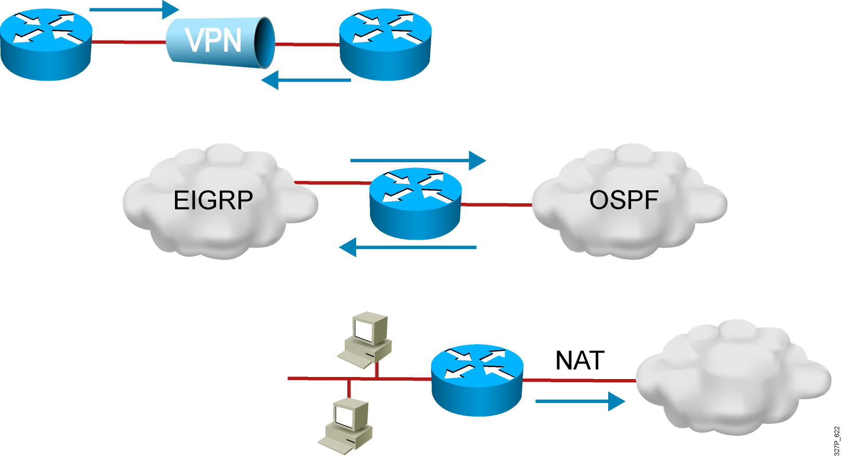
ACL的应用: Classification
Special handling for traffic based on packet tests
Notes:
Layer 3 of 3
Purpose: This figure is the last layer of the build for other uses of access lists.
Emphasize: Access lists are used to define input traffic for route filtering to restrict the contents of routing updates.
Transition: The following figure is a two-layer build to show the difference between inbound and outbound access lists.

Slide 5

入方向的ACL的操作
Routing Table
Entry？
N
ACL ?
Y
Permit
?
Y
N
Notes:
Layer 3 of 3
Purpose: Shows a deny result of the access list test.
Emphasize: Now the packet is discarded into the packet discard bucket. The unwanted packet has been denied access to the outbound interface.
The Notify Sender message shows a process like ICMP, returning an “administratively prohibited” message back to the sender.

Slide 6
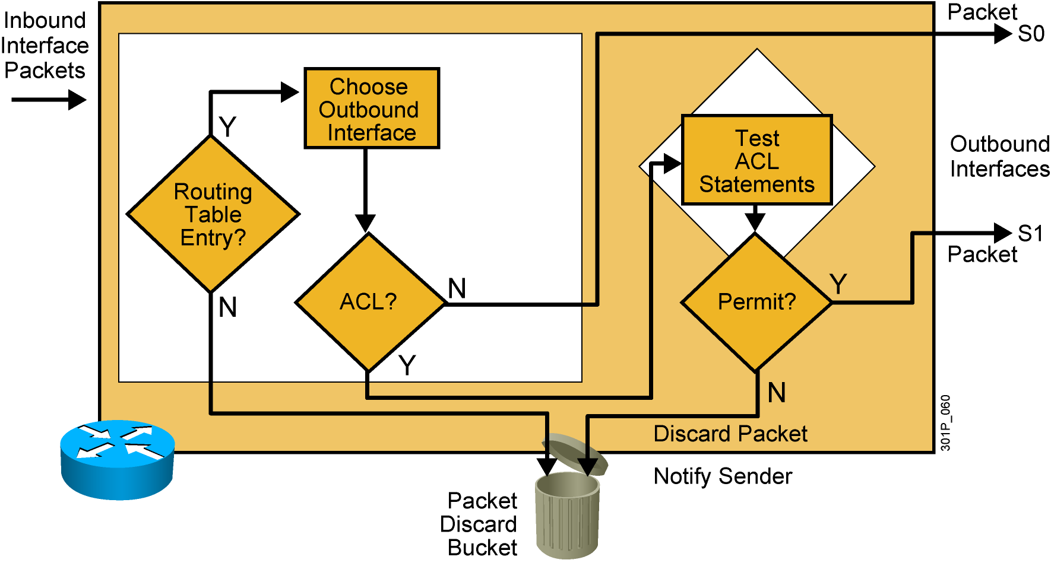
出方向的ACL的操作
  If no ACL statement matches, discard the packet.
Notes:
Layer 3 of 3
Purpose: Shows a deny result of the access list test.
Emphasize: Now the packet is discarded into the packet discard bucket. The unwanted packet has been denied access to the outbound interface.
The Notify Sender message shows a process like ICMP, returning an “administratively prohibited” message back to the sender.

Slide 7
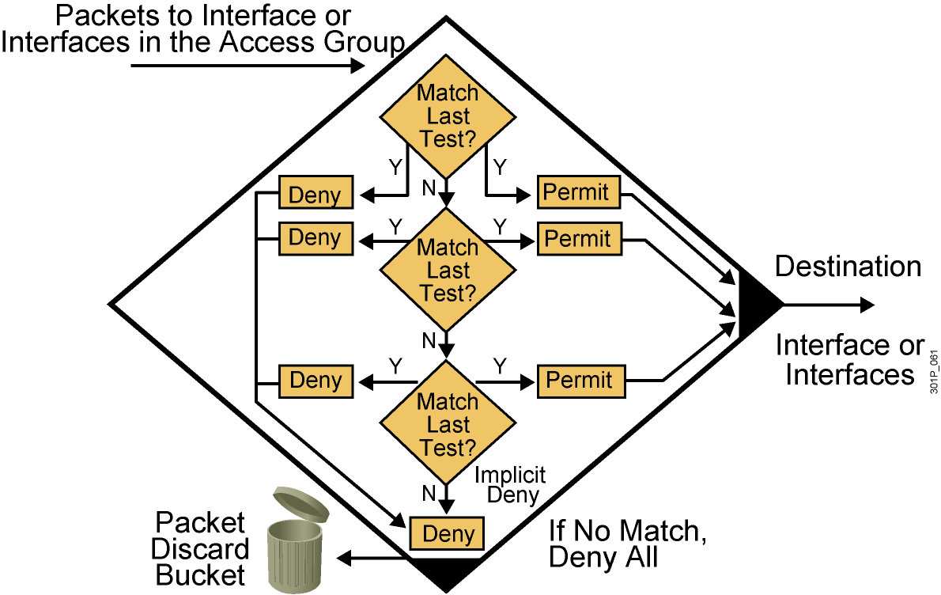
ACL的匹配: Deny or Permit
Notes:
Layer 4 of 4
Purpose: Shows the implicit “deny all.”
Emphasize: Describe the final access list test to match any packets not covered by earlier access list statements. All remaining packets match the “Implicit Deny” and are discarded into the bit bucket.

Slide 8
ACL的类型
Standard ACL
    Checks source address；
    Generally permits or denies entire protocol suite；
Extended ACL
    Checks source and destination address；
    Generally permits or denies specific protocols and applications；
Two methods used to identify standard and
extended ACLs:
    Numbered ACLs use a number for identification
    Named ACLs use a descriptive name or number for identification
Notes:
编号ACL
Layer 3 of 3
Purpose: Describe an inbound versus outbound access list on an interface.

Slide 9
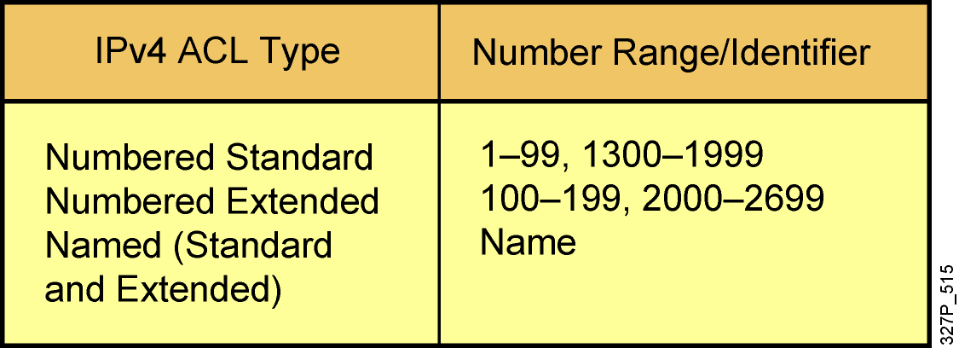
ACLs如何标识？
Numbered standard IPv4 lists (1–99) test conditions of all IP
packets for source addresses. Expanded range (1300–1999).
Numbered extended IPv4 lists (100–199) test conditions of source
and destination addresses, specific TCP/IP protocols, and destination
ports. Expanded range (2000–2699).
Named ACLs identify IP standard and extended ACLs with an
alphanumeric string (name).
Notes:
Layer 3 of 3
Emphasize: Layer 3—Adds the Novell IPX access lists covered in Chapter 11, “Configuring Novell IPX,” and the number ranges for these types of access lists. As of Release 11.2.4(F), IPX also supports named access lists.
Point out that number ranges generally allow 100 different access lists per type of protocol. When a given hundred-number range designates a standard access list, the rule is that the next hundred-number range is for extended access lists for that protocol.
Exceptions to the numbering classification scheme include AppleTalk and DECnet, where the same number range can identify various access list types.
For the most part, number ranges do not overlap between different protocols.
Note: With Cisco IOS 12.0, the IP access-lists range has been expanded to also include:
<1300-1999> IP standard access list (expanded range)
<2000-2699> IP extended access list (expanded range)

Slide 10
IP访问控制列表序列号
  Requires Cisco IOS Release 12.3
  Allows you to edit the order of ACL statements using sequence numbers
    In software earlier than Cisco IOS Release 12.3, a text editor is used to create ACL statements, then the statements are copied into the router in the correct order.
  Allows you to remove a single ACL statement from the list using a sequence number
    With named ACLs in software earlier than Cisco IOS Release 12.3, you must use no {deny | permit} protocol source source-wildcard destination destination-wildcard to remove an individual statement.
    With numbered ACLs in software earlier than Cisco IOS Release 12.3, you must remove the entire ACL to remove a single ACL statement.

Slide 11
ACL配置向导
  Standard or extended indicates what can be filtered.
  Only one ACL per interface, per protocol, and per direction is allowed.
  The order of ACL statements controls testing, therefore, the most specific statements go at the top of the list.
  The last ACL test is always an implicit deny everything else statement, so every list needs at least one permit statement.
  ACLs are created globally and then applied to interfaces for inbound or outbound traffic.
  An ACL can filter traffic going through the router, or traffic to and from the router, depending on how it is applied.
  When placing ACLs in the network:
    Place extended ACLs close to the source
    Place standard ACLs close to the destination

Slide 12
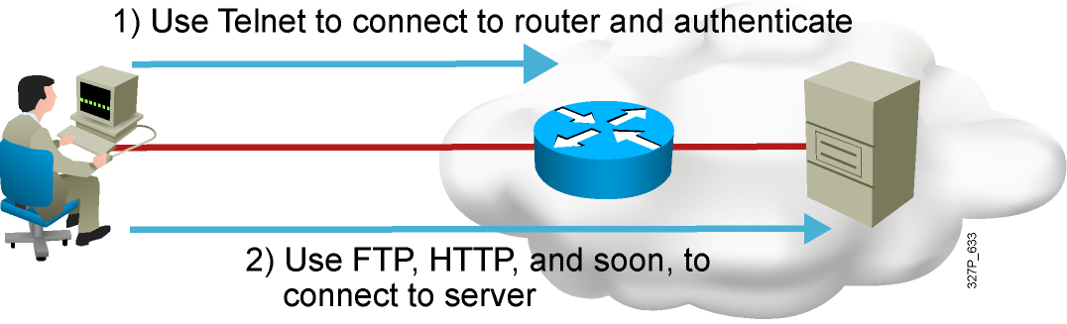
Dynamic ACLs
Dynamic ACLs (lock-and-key): Users that want to traverse the router
are blocked until they use Telnet to connect to the router and are
authenticated.
Notes:
动态访问表中，读者可以根据用户认证过程来创建特定的、临时的访问表项，一旦某个表项超时，就会自动从路由器中删除。
为192.168.1.0网段上通过认证的用户提供上网服务，但只允许进行Web浏览和FTP访问

Slide 13
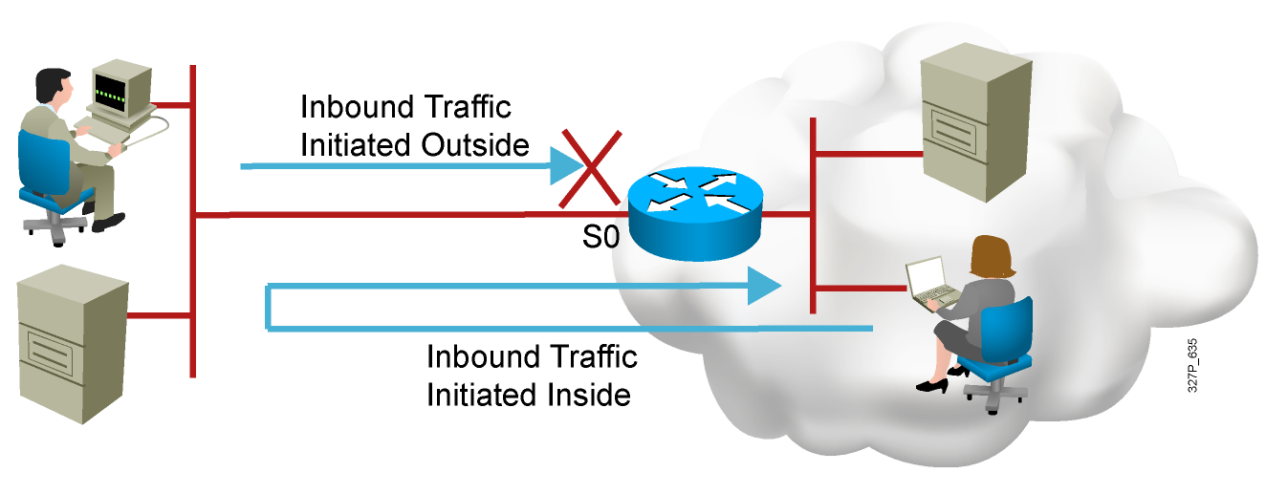
Reflexive ACLs
Reflexive ACLs: Used to allow outbound traffic and limit inbound
traffic in response to sessions that originate inside the router

Slide 14
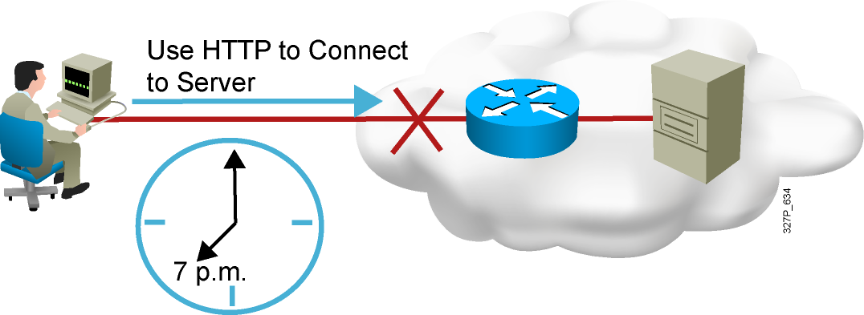
Time-Based ACLs
Time-based ACLs: Allow for access control
based on the time of day and week

Slide 15
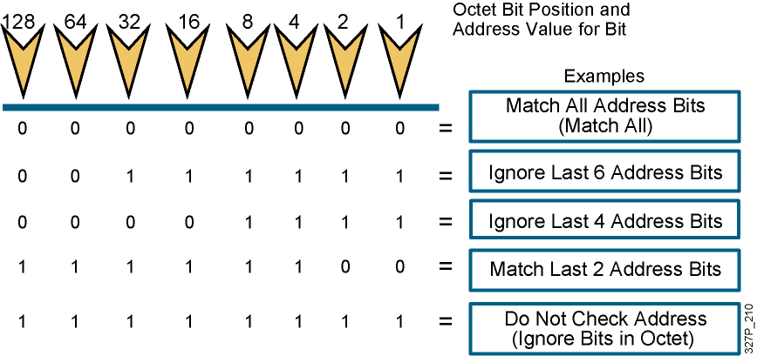
反掩码
  0 means to match the value of the corresponding address bit
  1 means to ignore the value of the corresponding address bit
Notes:
Purpose: This graphic describes the binary wildcard masking process.
Emphasize: Introduce the wildcard bit process. Tell students that the wildcard bit matching process is different than the IP subnet addressing mask covered earlier.
Illustrate how wildcard masking works using the examples shown in the graphic table.
The term wildcard masking is a nickname for this access list mask-bit-matching process. This nickname comes from an analogy of a wildcard that matches any other card in a poker game.
Emphasize the contrast between wildcard masks and subnet masks, stated in the Student Guide note. The confusion over wildcard and subnet masks can be a key obstacle to learning if students fail to understand the different uses of binary 0 and binary 1 in the two mask types.
Point out that the 1 bits in a wildcard mask need not be contiguous, while the 1 bits in a subnet mask need to be contiguous.
Wildcard is like the DOS “*” character.

Slide 16
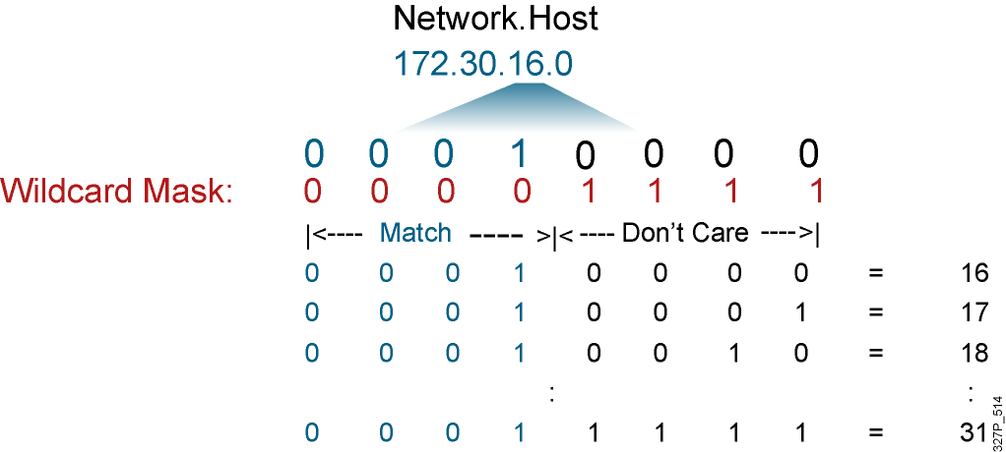
反掩码匹配IP子网
Match for IP subnets 172.30.16.0/24 to 172.30.31.0/24.
Address and wildcard mask:
172.30.16.0 0.0.15.255
Notes:
Purpose: This slide describes an example of how wildcard mask bits will match all hosts on subnets 172.30.16.0/24 to 172.30.31.0/24.
Emphasize: This process requires a thorough understanding of binary numbering, what values to use in the power of two bit positions, and how to convert a number from decimal to binary.
If some of your students seem to lack this understanding, tell them that responsibility for complex access list design is an advanced configuration skill. Later, this course offers a hands-on lab to allow practice designing simple access lists.
If you feel that your students need another example to improve their understanding of the process, prepare another example as a chalk talk. Consider having students volunteer to help as you solve your own example that lines up the binary bits of the address and the binary bits of the wildcard mask.

Slide 17
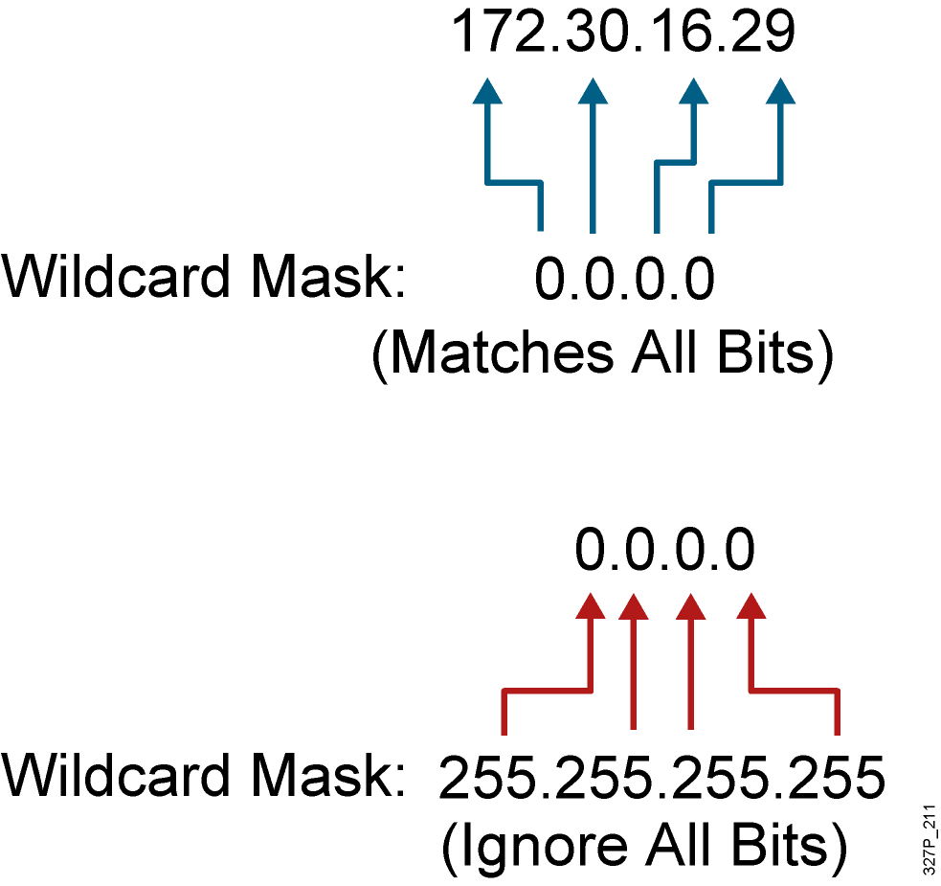
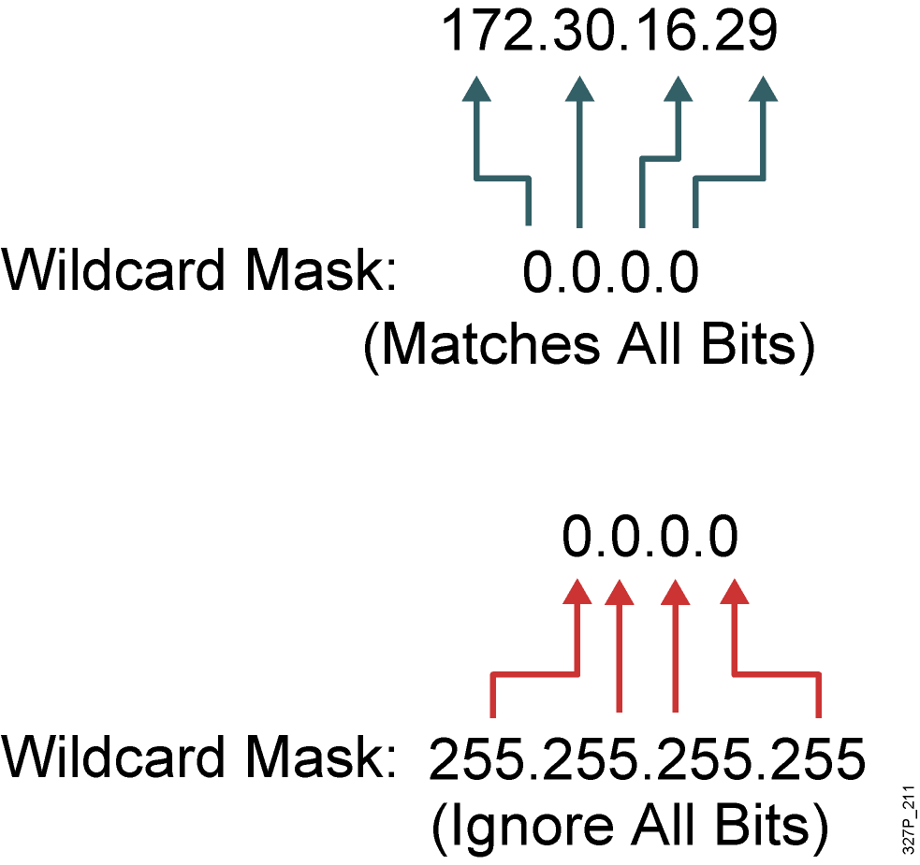
反掩码缩写
172.30.16.29 0.0.0.0 matches
all of the address bits
Abbreviate this wildcard mask
using the IP address preceded
by the keyword host
(host 172.30.16.29)
0.0.0.0 255.255.255.255
ignores all address bits
Abbreviate expression
with the keyword any
Notes:
Purpose: This graphic shows students how to use the host abbreviation in the extended access list wildcard mask.
Emphasize: This abbreviation means check the bit value in all bit positions, which has the effect of matching only the specified IP host address in all bit positions.

Slide 18
Configuring ACL
配置ACL

Slide 19
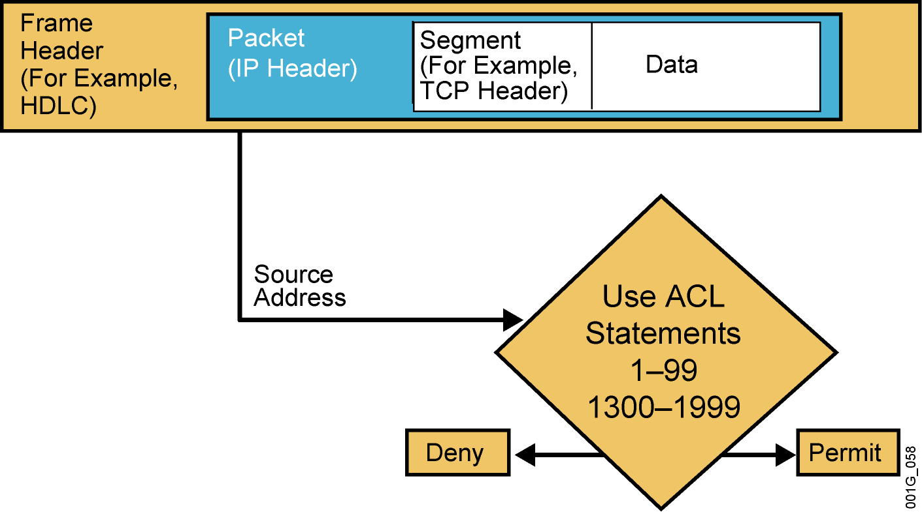
标准的数字IPV4访问控制列表
Notes:
Purpose: This graphic gives an overview of the type of TCP/IP packet tests that standard access lists can filter. It uses the encapsulation graphic and diamond decision graphic to remind students of material presented earlier in this course.

Slide 20
标准的数字IPV4访问控制列表的配置
Router(config)#
access-list access-list-number
{permit | deny | remark} source [mask]
Uses 1 to 99 for the access-list-number.
The first entry is assigned a sequence number of 10, and successive entries
are incremented by 10.
Default wildcard mask is 0.0.0.0 (only standard ACL).
no access-list access-list-number removes the entire ACL.
remark lets you add a description to the ACL.
Router(config-if)#
ip access-group access-list-number {in | out}
Activates the list on an interface.
Sets inbound or outbound testing.
no ip access-group access-list-number {in | out} removes the ACL from the interface.
Notes:
Layer 2 of 2
Purpose: This layer shows the ip access-group command.
Emphasize: The ip access-group command links an access list to an interface. Only one access list per interface, per direction, per protocol is allowed.
The ip access-group field descriptions are as follows:
list—Number of the access list to be linked to this interface.
direction—Default is outbound.
Note: Create the access list first before applying it to the interface. If it is applied to the interface before it is created, the action will be to permit all traffic. However, as soon as you create the first statement in the access list, the access list will be active on the interface. Since there is the implicit deny all at the end of every access list, the access list may cause most traffic to be blocked on the interface.
To remove an access list, remove it from all the interfaces first, then remove the access list. In older versions of Cisco IOS, removing the access list without removing it from the interface can cause problems.

Slide 21
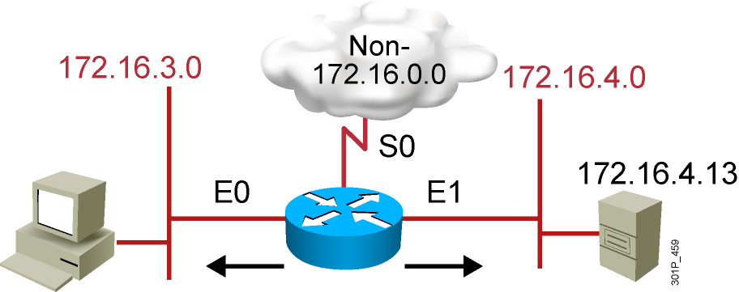
标准的数字IPV4访问控制列表-举例 1
Router(config)# access-list 1 permit 172.16.0.0 0.0.255.255
(implicit deny all - not visible in the list)
(access-list 1 deny 0.0.0.0 255.255.255.255)
Router(config)# interface ethernet 0
Router(config-if)# ip access-group 1 out
Router(config)# interface ethernet 1
Router(config-if)# ip access-group 1 out
Permit my network only
Notes:
Layer 2 of 2
Emphasize: Because of the implicit deny all, all non-172.16.x.x traffic is blocked going out E0 and E1.
Note: The red arrows represent the access list is applied as an outbound access list.

Slide 22
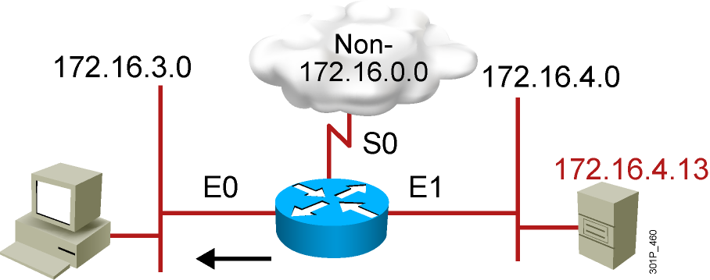
标准的数字IPV4访问控制列表-举例 2
Router(config)# access-list 1 deny 172.16.4.13 0.0.0.0
Router(config)# access-list 1 permit 0.0.0.0 255.255.255.255
(implicit deny all)
(access-list 1 deny 0.0.0.0 255.255.255.255)
Router(config)# interface ethernet 0
Router(config-if)# ip access-group 1 out
Deny a specific host
Notes:
Layer 3 of 3
Emphasize: Only host 172.16.4.13 is blocked from going out on E0 to subnet 172.16.3.0.
Ask the students what will happen if the access list is placed as an input access list on E1 instead. Host 172.16.4.13 will be blocked from going out to the non-172.16.0.0 cloud, as well as to subnet 172.16.3.0.
Note: The red arrows represent the access list is applied as an outbound access list.

Slide 23
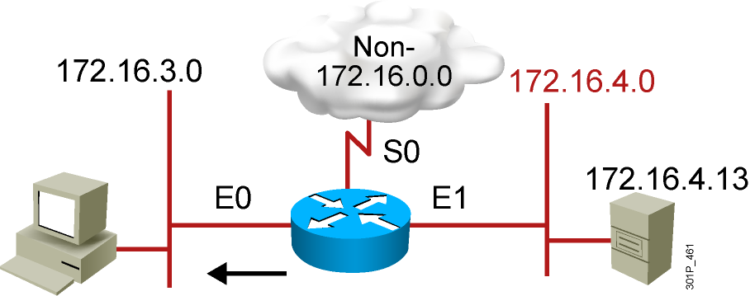
标准的数字IPV4访问控制列表-举例 3
Router(config)# access-list 1 deny 172.16.4.0 0.0.0.255
Router(config)# access-list 1 permit any
(implicit deny all)
(access-list 1 deny 0.0.0.0 255.255.255.255)
Router(config)# interface ethernet 0
Router(config-if)# ip access-group 1 out
Deny a specific subnet
Notes:
Layer 2 of 2
Emphasize: All hosts on subnet 172.16.4.0 are blocked from going out on E0 to subnet 172.16.3.0.
Note: The red arrows represent the access list is applied as an outbound access list.

Slide 24
采用标准的ACL控制VTY的接入
Router(config-line)#
access-class access-list-number {in | out}
Restricts incoming or outgoing connections between a particular
vty and the addresses in an ACL
Example:
access-list 12 permit 192.168.1.0 0.0.0.255
(implicit deny any)
!
line vty 0 4
access-class 12 in
Permits only hosts in network 192.168.1.0 0.0.0.255 to connect
to the router vty lines
Notes:
Purpose: This example shows how to restrict incoming Telnet sessions to the router’s vty ports.
Emphasize: The access class is applied as an input filter.
Note: Ask the student about the effect of changing the direction of the access class to outbound instead of inbound.
Now the router can accept incoming Telnet sessions to its vty ports from all hosts, but will block outgoing Telnet sessions from its vty ports to all hosts except hosts in network 192.89.55.0.
Once a user is Telneted into a router’s vty port, the outbound access-class filter will prevent the user from Telneting to other hosts as specified by the standard access list.
Remember, when an access list is applied to an interface, it only blocks or permits traffic going through the router, it does not block or permit traffic initiated from the router itself.

Slide 25
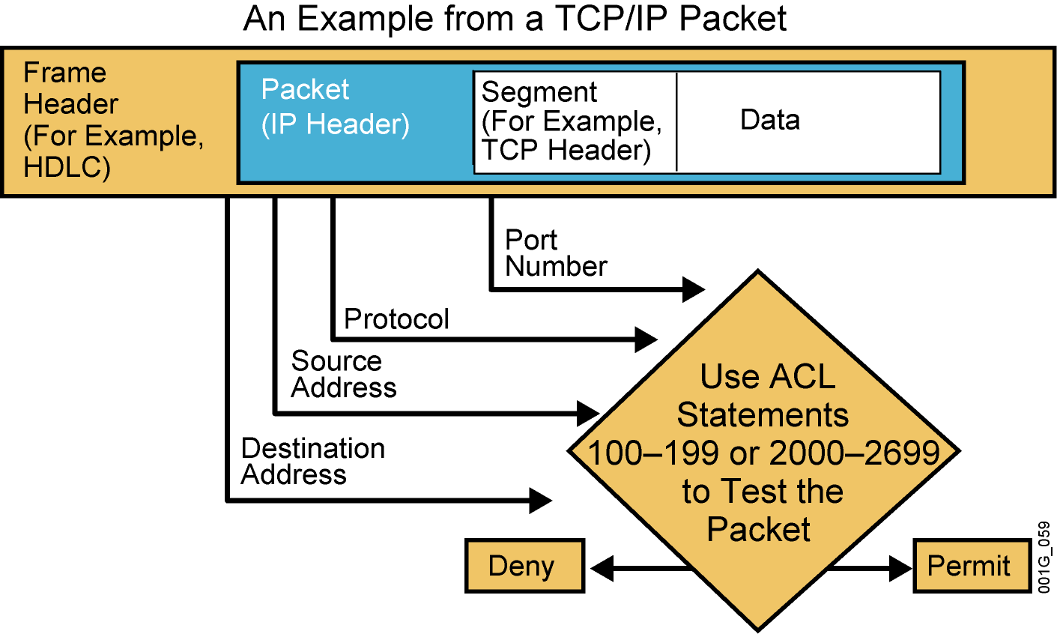
扩展的数字IPV4访问控制列表
Notes:
Purpose: This graphic gives an overview of the type of TCP/IP packet tests that extended access lists can filter. It uses the encapsulation graphic and diamond decision graphic to remind students of material presented earlier in this course.

Slide 26
扩展的数字IPV4访问控制列表的配置
Router(config)#
access-list access-list-number {permit | deny}
protocol source source-wildcard [operator port]
destination destination-wildcard [operator port]
[established] [log]
Sets parameters for this list entry
Router(config-if)#
ip access-group access-list-number {in | out}
Activates the extended list on an interface
Notes:
Layer 2 of 2
Purpose: Layer 2—Adds the access-group command for IP.
Emphasize: The list number must match the number (100 to 199) you specified in the access-list command.

Slide 27
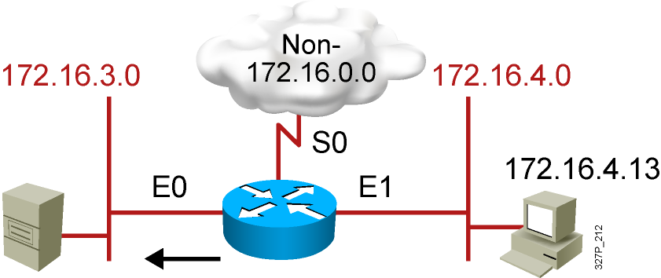
扩展的数字IPV4访问控制列表-举例 1
Router(config)# access-list 101 deny tcp 172.16.4.0 0.0.0.255 172.16.3.0 0.0.0.255 eq 21
Router(config)# access-list 101 deny tcp 172.16.4.0 0.0.0.255 172.16.3.0 0.0.0.255 eq 20
Router(config)# access-list 101 permit ip any any
(implicit deny all)
(access-list 101 deny ip 0.0.0.0 255.255.255.255 0.0.0.0 255.255.255.255)
Router(config)# interface ethernet 0
Router(config-if)# ip access-group 101 out
Deny FTP traffic from subnet 172.16.4.0 to subnet 172.16.3.0 out E0
Permit all other traffic
Notes:
Layer 3 of 3

Slide 28
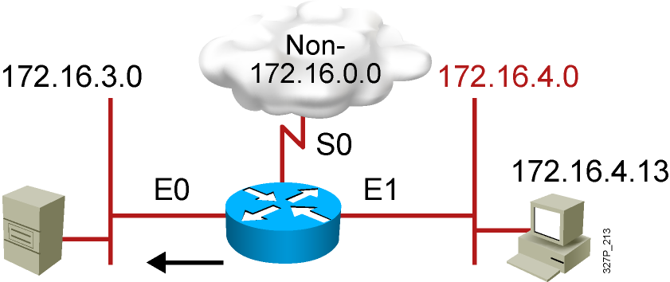
扩展的数字IPV4访问控制列表-举例 2
Router(config)# access-list 101 deny tcp 172.16.4.0 0.0.0.255 any eq 23
Router(config)# access-list 101 permit ip any any
(implicit deny all)
Router(config)# interface ethernet 0
Router(config-if)# ip access-group 101 out
Deny only Telnet traffic from subnet 172.16.4.0 out E0
Permit all other traffic
Notes:
Layer 3 of 3

Slide 29
命名的IPV4访问控制列表的配置
Router(config)#
ip access-list {standard | extended} name
Alphanumeric name string must be unique
Router(config {std- | ext-}nacl)#
[sequence-number] {permit | deny} {ip access list test conditions}
{permit | deny} {ip access list test conditions}
If not configured, sequence numbers are generated automatically starting at 10 and
incrementing by 10
no sequence number removes the specific test from the named ACL
Router(config-if)#
ip access-group name {in | out}
Activates the named IP ACL on an interface
Notes:
Layer 3 of 3
Purpose: Layer 3—Finishes with the new form of the access-group command, now able to refer to an IP access list name as well as an access list number.
Emphasize: Introduced with Cisco IOS Release 11.2, named access lists:
Intuitively identify IP access lists using alphanumeric identifiers.
Remove the limit on the number of access lists (previously 99 for IP standard and 100 for IP extended access lists).
Allow per-access-list statement deletions (previously the entire numbered access list needed to be deleted as a single entity).
Require Cisco IOS Release 11.2 or later.

Slide 30
命名的IPV4访问控制列表-举例 1
Router(config)#ip access-list standard troublemaker
Router(config-std-nacl)#deny host 172.16.4.13
Router(config-std-nacl)#permit 172.16.4.0 0.0.0.255
Router(config-std-nacl)#interface e0
Router(config-if)#ip access-group troublemaker out
Deny a specific host
Notes:
Layer 2 of 2
Emphasize: All hosts on subnet 172.16.4.0 are blocked from going out on E0 to subnet 172.16.3.0.
Note: The red arrows represent the access list is applied as an outbound access list.

Slide 31

命名的IPV4访问控制列表-举例 2
Router(config)#ip access-list extended badgroup
Router(config-ext-nacl)#deny tcp 172.16.4.0 0.0.0.255 any eq 23
Router(config-ext-nacl)#permit ip any any
Router(config-ext-nacl)#interface e0
Router(config-if)#ip access-group badgroup out
Deny Telnet from a specific subnet
Notes:
Layer 2 of 2
Emphasize: All hosts on subnet 172.16.4.0 are blocked from going out on E0 to subnet 172.16.3.0.
Note: The red arrows represent the access list is applied as an outbound access list.

Slide 32
解释ACL的配置
Router(config)#
ip access-list {standard|extended} name
Creates a named ACL
Router(config {std- | ext-}nacl)#
remark remark
Creates a named ACL comment
Or
Router(config)#
access-list access-list-number remark remark
Creates a numbered ACL comment

Slide 33
查看ACL的配置
Router# show access-lists {access-list number|name}
Router# show access-lists
Standard IP access list SALES
10 deny 10.1.1.0, wildcard bits 0.0.0.255
20 permit 10.3.3.1
30 permit 10.4.4.1
40 permit 10.5.5.1
Extended IP access list ENG
10 permit tcp host 10.22.22.1 any eq telnet (25 matches)
20 permit tcp host 10.33.33.1 any eq ftp
30 permit tcp host 10.44.44.1 any eq ftp-data
Displays all access lists
Notes:
Purpose: This slide introduces the show access-lists command used to verify access lists.
Emphasize: This is the most consolidated method for seeing several access lists.
Note: The implicit deny all statement is not displayed unless it is explicitly entered in the access list.

Slide 34
查看ACL的配置
Router# show ip interfaces e0
Ethernet0 is up, line protocol is up
Internet address is 10.1.1.11/24
Broadcast address is 255.255.255.255
Address determined by setup command
MTU is 1500 bytes
Helper address is not set
Directed broadcast forwarding is disabled
Outgoing access list is not set
Inbound access list is 1
Proxy ARP is enabled
Security level is default
Split horizon is enabled
ICMP redirects are always sent
ICMP unreachables are always sent
ICMP mask replies are never sent
IP fast switching is enabled
IP fast switching on the same interface is disabled
IP Feature Fast switching turbo vector
IP multicast fast switching is enabled
IP multicast distributed fast switching is disabled
<text ommitted>
Notes:
240, 197, 102

Slide 35
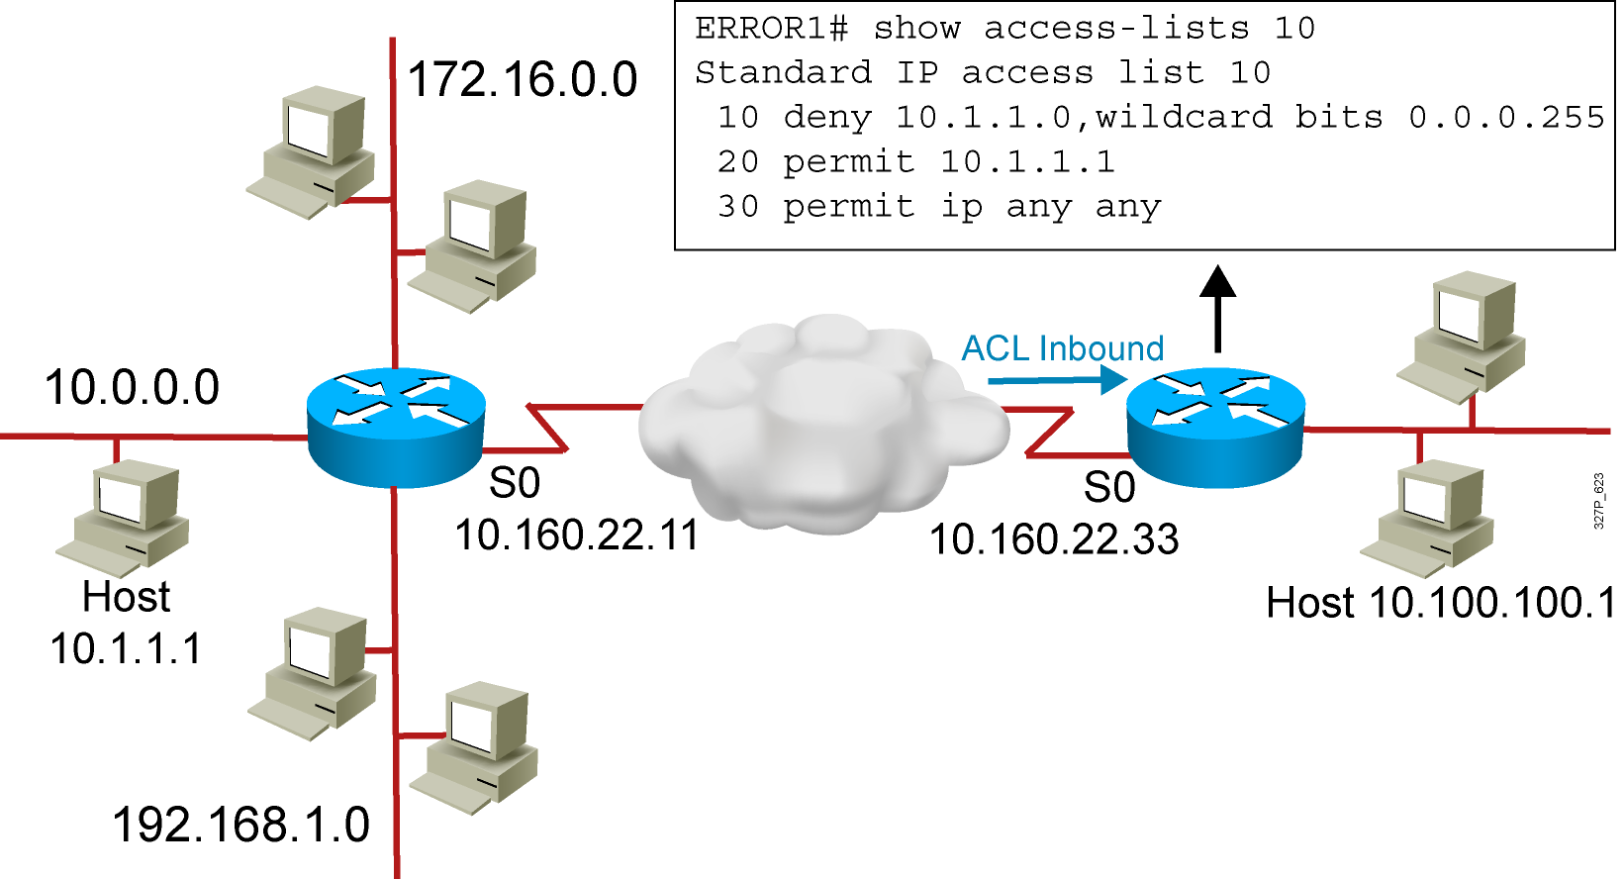
ACL的故障排除
Error 1: Host 10.1.1.1 has no connectivity with 10.100.100.1.
Notes:
Layer 3 of 3
Purpose: Shows a deny result of the access list test.
Emphasize: Now the packet is discarded into the packet discard bucket. The unwanted packet has been denied access to the outbound interface.
The Notify Sender message shows a process like ICMP, returning an “administratively prohibited” message back to the sender.

Slide 36
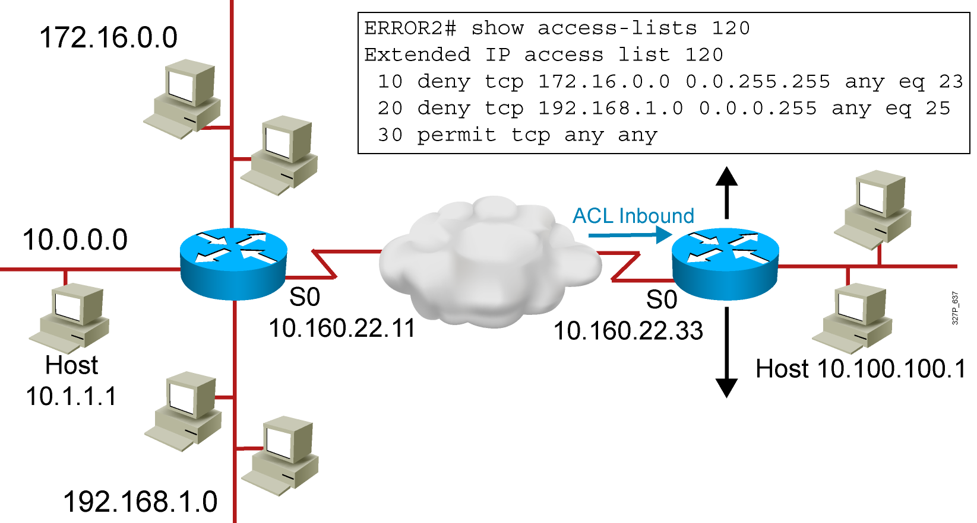
ACL的故障排除
Error 2: The 192.168.1.0 network cannot use TFTP to connect to
10.100.100.1.
Notes:
TFTP UDP 69
Layer 3 of 3
Purpose: Shows a deny result of the access list test.
Emphasize: Now the packet is discarded into the packet discard bucket. The unwanted packet has been denied access to the outbound interface.
The Notify Sender message shows a process like ICMP, returning an “administratively prohibited” message back to the sender.

